Slide 1
Machine Learning
Nearest Neighbor Introduction

Slide 2


Nearest Neighbor Introduction
For both classification and regression predictive problems, KNN can be used. But it is more widely used in classification problems in the industry. To evaluate any technique we generally look at 3 important aspects:
1. Ease to interpret output
2. Calculation time
3. Predictive Power
Let us take a few examples to place KNN in the scale:
KNN algorithm fairs across all parameters of considerations. It is commonly used for its ease of interpretation and low calculation time.

Slide 3
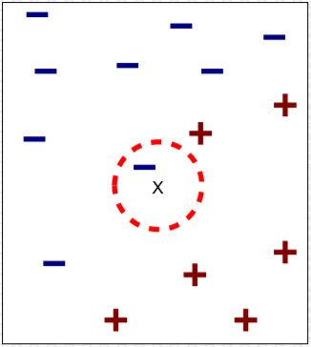
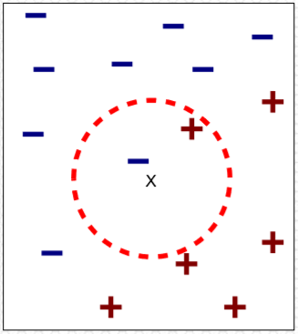
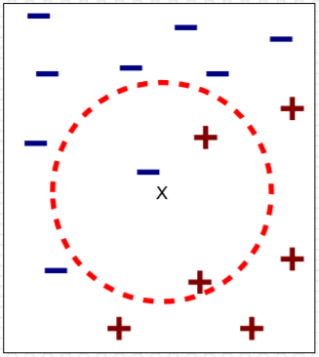
Nearest Neighbor Introduction
(a) 1-nearest neighbor
(b) 2-nearest neighbor
(c) 3-nearest neighbor
K-nearest neighbors of a record x are data points that have the k smallest distance to x

Slide 4
Basic k-nearest Neighbor Classification
Training method:
Save the training examples
At prediction time:
Find the k training examples (x₁,y₁,…x_{k},y_{k}) that are nearest to the test example x
Predict the most frequent class among those y_{i} s.
Improvements:
Weighting examples from the neighborhood
Measuring closeness
Finding close examples in a large training set quickly

Slide 5
Machine Learning
Determining Distance & Class

Slide 6
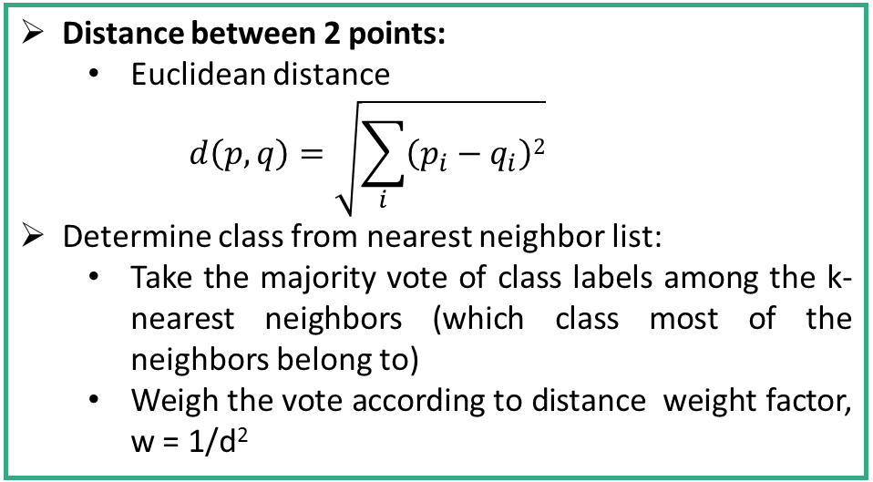
Determining Distance & Class
Distance between 2 points:
Euclidean distance
$$d\left(p,q\right)=\sqrt{\sum_{i}{\left(p_{i}−q_{i}\right)2}}$$
Determine class from nearest neighbor list:
Take the majority vote of class labels among the k-nearest neighbors (which class most of the neighbors belong to)
Weigh the vote according to distance weight factor, w = 1/d²

Slide 7
Issues in Nearest Neighbor Classification
Choosing value of k
If k is too small, sensitive to noise points
If k is too large, neighborhood may include points from other classes
Scaling Issues:
Attributes may have to be scaled to prevent distance measures from being dominated by one of the attributes, e.g.
height of a person may vary from 1.5m to 1.8m
weight of a person may vary from 90lb to 300lb
income of a person may vary from $10K to $1M

Slide 8
Issues in Nearest Neighbor (Contd.)
Problem with Euclidean measure
High dimensional data (curse of dimensionality)
Can produce counter-intuitive results
Solution – Normalize the vectors to unit length
1 1 1 1 1 1 1 1 1 1 1 0
1 0 0 0 0 0 0 0 0 0 0 0
VS
0 1 1 1 1 1 1 1 1 1 1 1
0 0 0 0 0 0 0 0 0 0 0 1
D=1.4142
D=1.4142

Slide 9
Machine Learning
Selection of Value of K

Slide 10
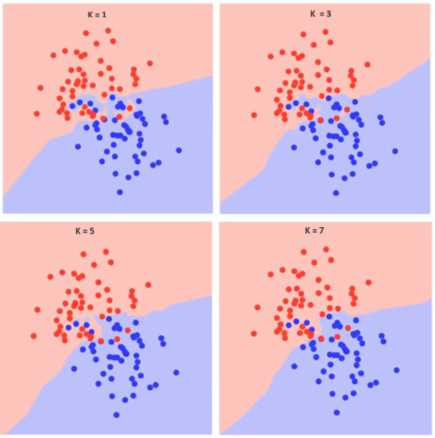
Selection of Value of K
How do we choose the factor K?
Following are the different boundaries separating the two classes with different values of K.
K = 1
K = 3
K = 5
K = 7

Slide 11
Selection of Value of K
If you watch carefully, you can see that the boundary becomes smoother with increasing value of K. With K increasing to infinity it finally becomes all blue or all red depending on the total majority.
K = 1
K = 3
K = 5
K = 7

Slide 12
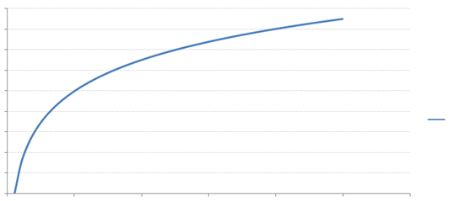
Selection of Value of K
Following is the curve for the training error rate with varying value of K :
The error rate at K=1 is always zero for the training sample. This is because the closest point to any training data point is itself. Hence the prediction is always accurate with K=1.
1.8
1.6
1.4
1.2
1
0.8
Error
0.6
0.4
0.2
0
0
10
20
30
40
50
60
K-Value

Slide 13
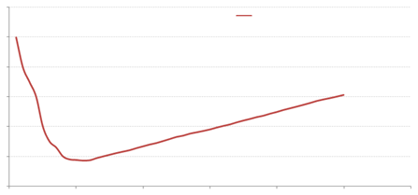
Selection of Value of K
Following is the curve for the training error rate with varying value of K :
At K=1, we were overfitting the boundaries. Hence, error rate initially decreases and reaches a minima then after it increases with increasing K. To get the optimal value of K, you can segregate the training and validation from the initial dataset. Now plot the validation error curve to get the optimal value of K. This value of K should be used for all predictions.
Let us go for a practical demonstration…
60
Validation error
50
40
30
20
10
0
30
50
60
0
10
20
40
K-Value

Slide 14
Machine Learning
Review of KNN Algorithm

Slide 15
Review of KNN Algorithm
The k-NN algorithm for continuous-valued target functions
Calculate the mean values of the k nearest neighbors
Distance-weighted nearest neighbor algorithm
Weight the contribution of each of the k neighbors according to their distance to the query point x_{q} giving greater weight to closer neighbors
Similarly, for real-valued target functions
Robust to noisy data by averaging k-nearest neighbors
Curse of dimensionality: distance between neighbors could be dominated by irrelevant attributes.
To overcome it, axes stretch or elimination of the least relevant attributes.

Slide 16
Review of KNN Algorithm
Lazy vs. eager learning
Lazy learning (e.g., instance-based learning): Simply stores training data (or only minor processing) and waits until it is given a test tuple
Eager learning (the above discussed methods): Given a set of training set, constructs a classification model before receiving new (e.g., test) data to classify
Lazy learning takes less time in training but more time in predicting
Accuracy
Lazy method effectively uses a richer hypothesis space since it uses many local linear functions to form its implicit global approximation to the target function
Eager: must commit to a single hypothesis that covers the entire instance space
k-NN classifiers are lazy learners
It does not build models explicitly
Unlike eager learners such as decision tree induction and rule-based systems
Classifying unknown records are relatively expensive

Slide 17
Machine Learning
Implementation of KNN Algorithm

